Slide 1

Drug Benefits Review
Using Text and Sentiment Analysis

Slide 2





Table of Content
Description of Drug Benefits Dataset and Problems
Pre-processing of Dataset
Explanation of Analysis
Outcomes from the Drug Dataset
Actionable Recommendations

Slide 3
Drug Dataset Description
Comprehensive Drug Comments Collection
Over 4,000 comments from the FDA
Insights into patient experiences and sentiments
Detailed Record Structure
Includes drug name, rating, and treated condition
Reviews on benefits and side effects
Analysis of Patient Perspectives
Focus on benefitsReview column for trends
Understanding consumer reactions to drugs
Key Columns in the Drug Dataset
ID | Drug Name | Rating | Condition | Benefits Review | Side Effects Review | Comments Review
Record ID | Name of the drug | Patient rating | Condition treated | Review of benefits | Description of side effects | Additional comments

Slide 4
FDA Comments and Columns
Column Name | Description
id | Record ID
drugName | Name of the drug
rating | Patient rating of the drug
condition | Condition treated by the drug
benefitsReview | Review of the drug's benefits by the patient
sideEffectsReview | Review of side effects experienced by the patient
commentsReview | Additional comments or reviews by the patient

Slide 5
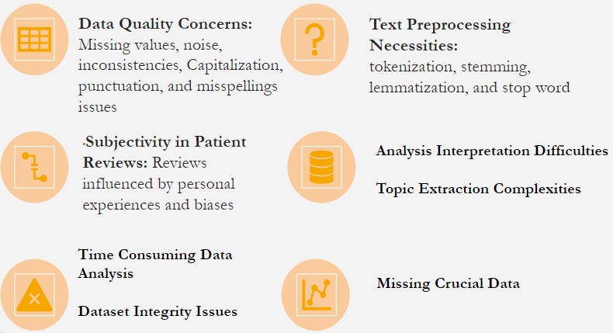
Problems with Drug Dataset

Slide 6
Preprocessing Steps for Analysis
Steps for Pre-Processing 'benefitsReview' Text Data
Step | Action | Purpose
1 | Convert to lowercase | Ensure consistency
2 | Remove noise elements | Clean data
3 | Tokenize text | Prepare for analysis
4 | Lemmatize words | Normalize data
5 | Remove stop words | Focus on valuable words
6 | Handle missing data | Maintain data integrity
Consistency in Text Data
Convert text to lowercase to avoid case-sensitive duplication
Cleaning Text Content
Remove URLs, special characters, numbers, and punctuation
Tokenization
Split text into individual words for analysis
Normalization
Lemmatize words to their base form
Stop Words Removal
Eliminate common words that add little value
Data Integrity
Handle missing data by dropping incomplete rows

Slide 7



Analysis
Text Analysis
Sentiment Analysis
N-gram Analysis
Topic Analysis
Word Frequency and Visualization

Slide 8
Text Mining Analysis
Top Words in Identified Topics
Topic Number | Top Words
1 | Word1, Word2, Word3, ..., Word10
2 | Word1, Word2, Word3, ..., Word10
3 | Word1, Word2, Word3, ..., Word10
4 | Word1, Word2, Word3, ..., Word10
5 | Word1, Word2, Word3, ..., Word10
6 | Word1, Word2, Word3, ..., Word10
Text Mining Techniques
Utilization of CountVectorizer for token matrix
Employment of LDA for theme identification
Insights from 'benefitsReview'
Top 10 words for 6 topics reveal dominant themes

Slide 9
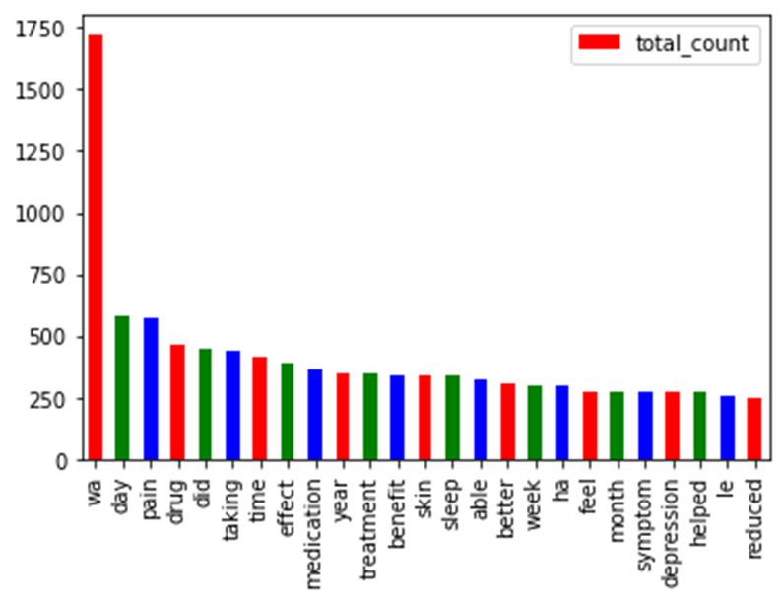
Text Mining Analysis
Top 25 words

Slide 10
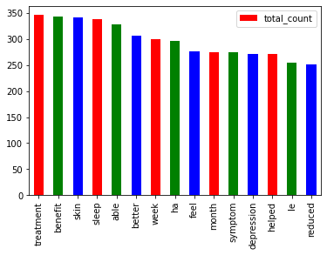
Text Mining Analysis
After excluding top 10 to get your Middle Group

Slide 11
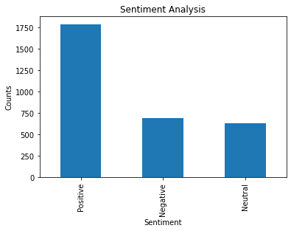
Sentiment Classification
Review Sentiment Classification
Utilized TextBlob library to calculate polarity scores
Categorized reviews based on sentiment polarity
Sentiment Distribution Visualization
Displayed using a bar chart
Provided an overview of drug sentiment
Data Export for In-Depth Analysis
Positive and negative reviews saved in separate CSV files

Slide 12
Sentiment analysis
Positive Sentiment Reinforcement
Utilize drugs with the most positive reviews in marketing
Incorporate patient testimonials showcasing benefits
Employ promotional materials that highlight effectiveness

Slide 13
N-gram and Topic Analysis
N-gram Analysis:
The code performs n-gram analysis using both sci-kit-learn’s Count Vectorizer and NLTK (Natural Language Toolkit) libraries.
It extracts the most frequent 2-gram and 3-gram phrases, providing insights into common word combinations discussed in the reviews.
Topic Analysis:
Conducted topic modeling to identify common themes in the benefits reviews.
This helped us understand the main topics discussed by consumers.

Slide 14
Intuitive Visualizations
Visual Data Analysis in Drug Reviews
Word clouds showcase frequently mentioned terms
Frequency plots highlight common phrases
Consumer Feedback Interpretation
Visualizations offer intuitive topic comprehension
Themes in reviews are easily identified

Slide 15
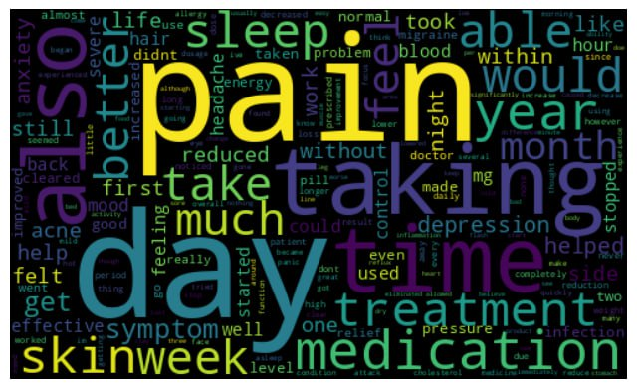
Word Frequency and Visualizations
Visual Analysis of Drug Reviews
Word clouds and frequency plots used for visualization
Highlighting most-used words and phrases
Intuitive Understanding of Consumer Discussions
Visualizations reveal prominent topics and themes

Slide 16
Justifiable and Actionable Recommendations
Positive Sentiment Reinforcement
Negative Sentiment Mitigation
Continuous Monitoring
Proactive Safety Measures
Consumer Insight Surveys
Utilization of NLP Tools
Improved Drug Communication
Enhanced Feedback Mechanisms
Personalized Medicine Campaigns
Strengthened Post-Market Surveillance
Patient Education and Support
Targeted Product Development

Slide 17


Slide 18
Presented by:
Kemisola Kasali

